Slide 1

Graph Theory
Private training
GHN OpsTech
NamPH

Slide 2
Agenda
What is graph ?
How to implement in computer ?
Basic pathfinding algorithm:
Depth First Search
Breadth First Search

Slide 3
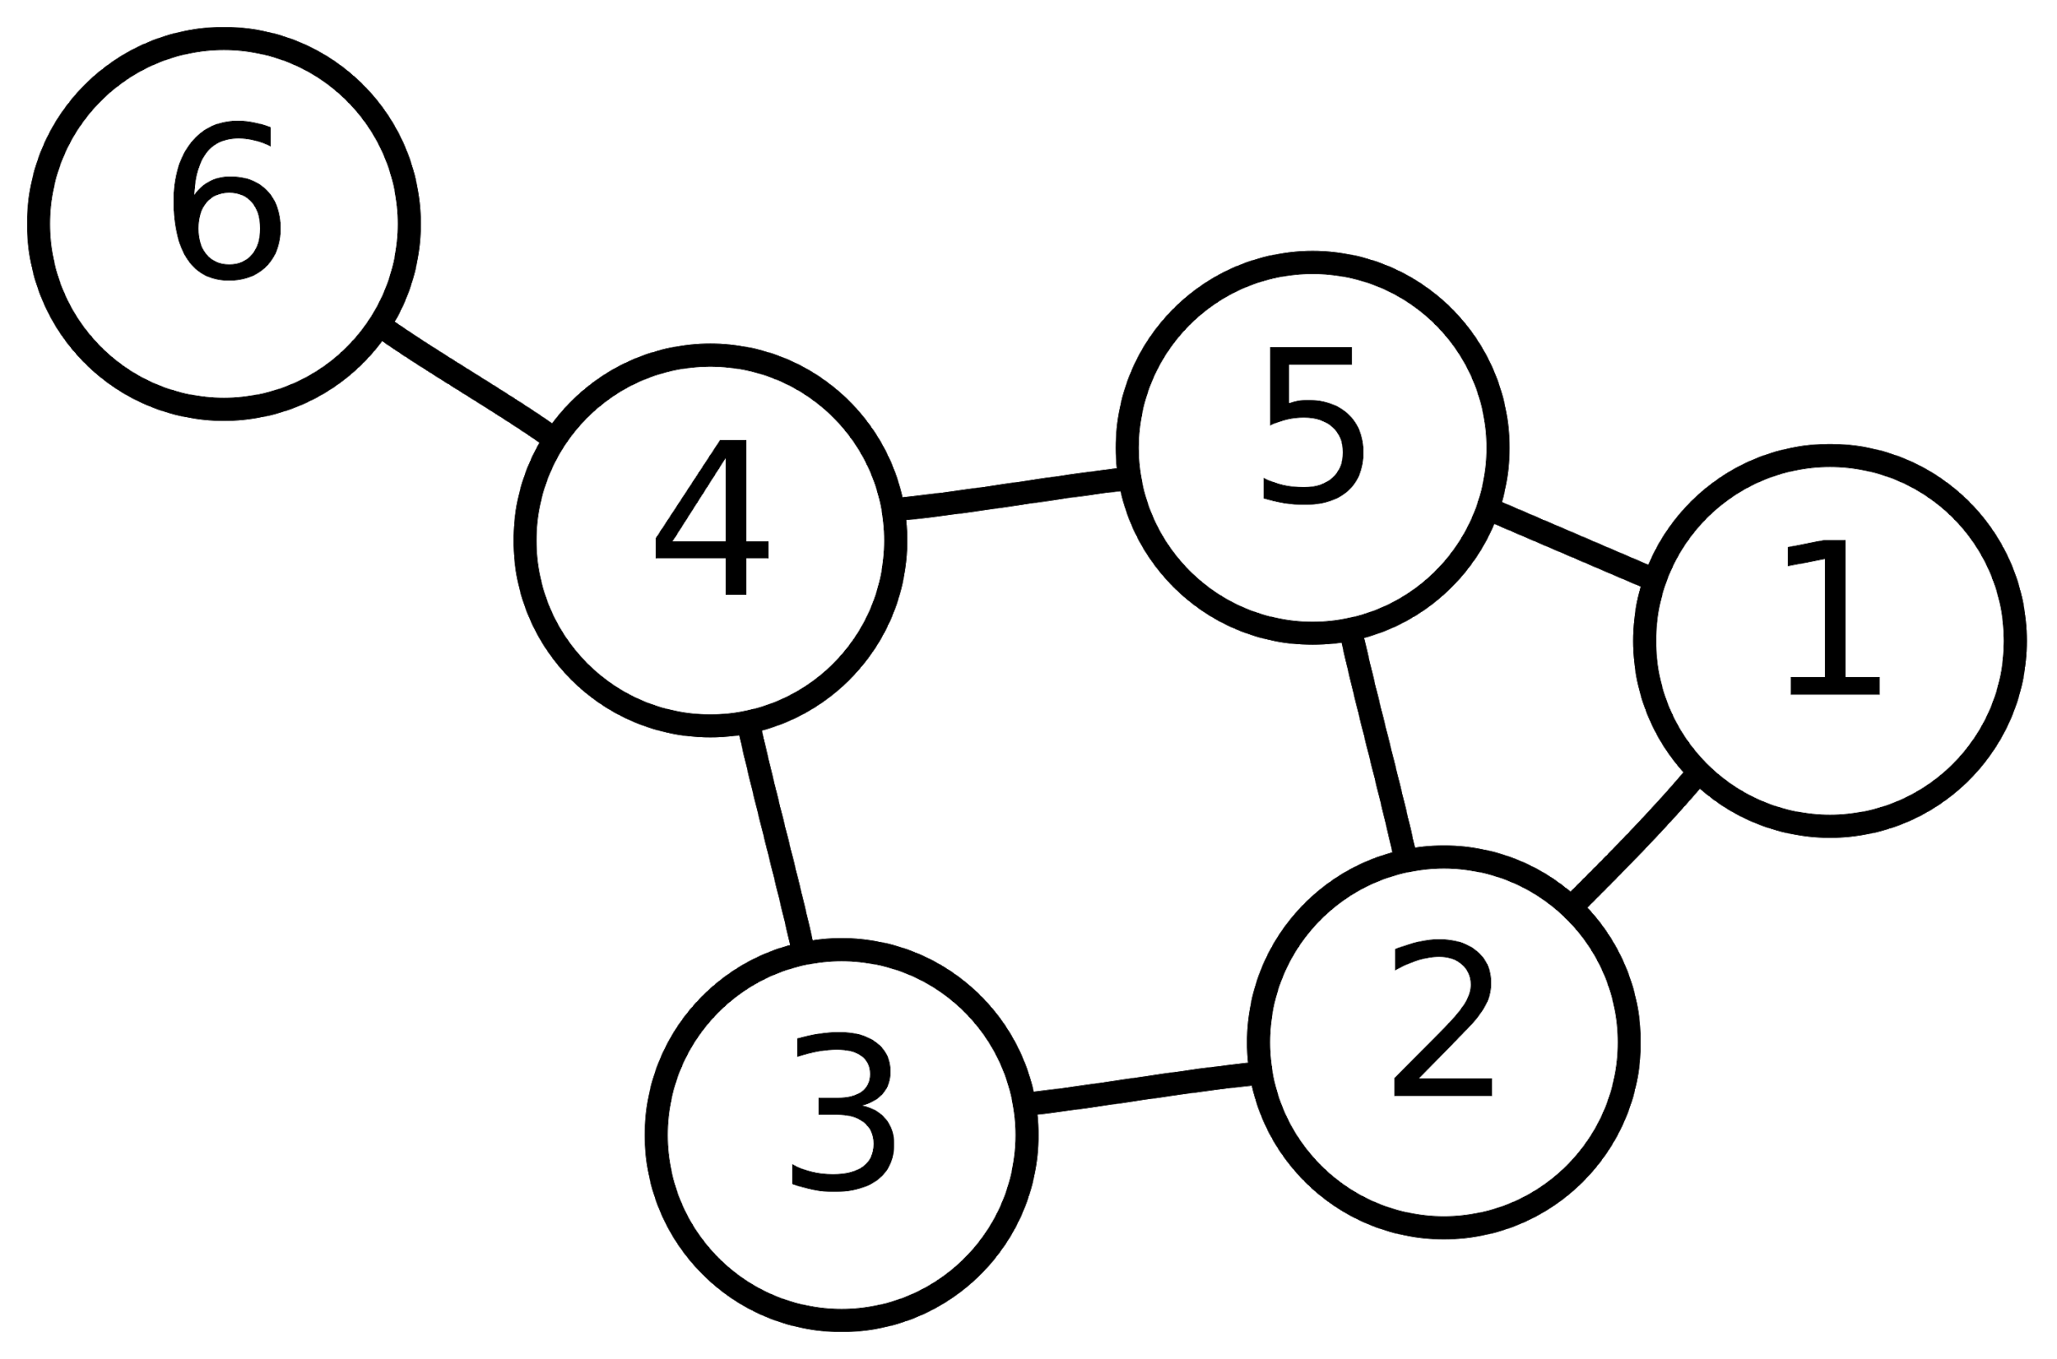
Graph
Is a pair of vertices & edges
→ G = ( V, E )
V is a set of vertices
E is a set of edges, where each:
Connect two vertices x,y
x != y
x,y ∈ V

Slide 4
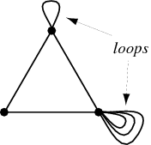
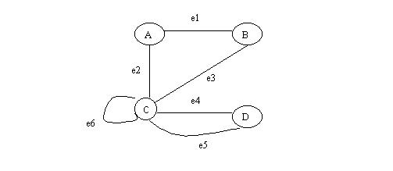
Terms
Loop is an edge which joins a vertex to itself.
Parallel edges is more than one edge joins two vertices.
Simple graph is a graph which don't have loop or parallel edges.
Not simple graph → multigraph

Slide 5
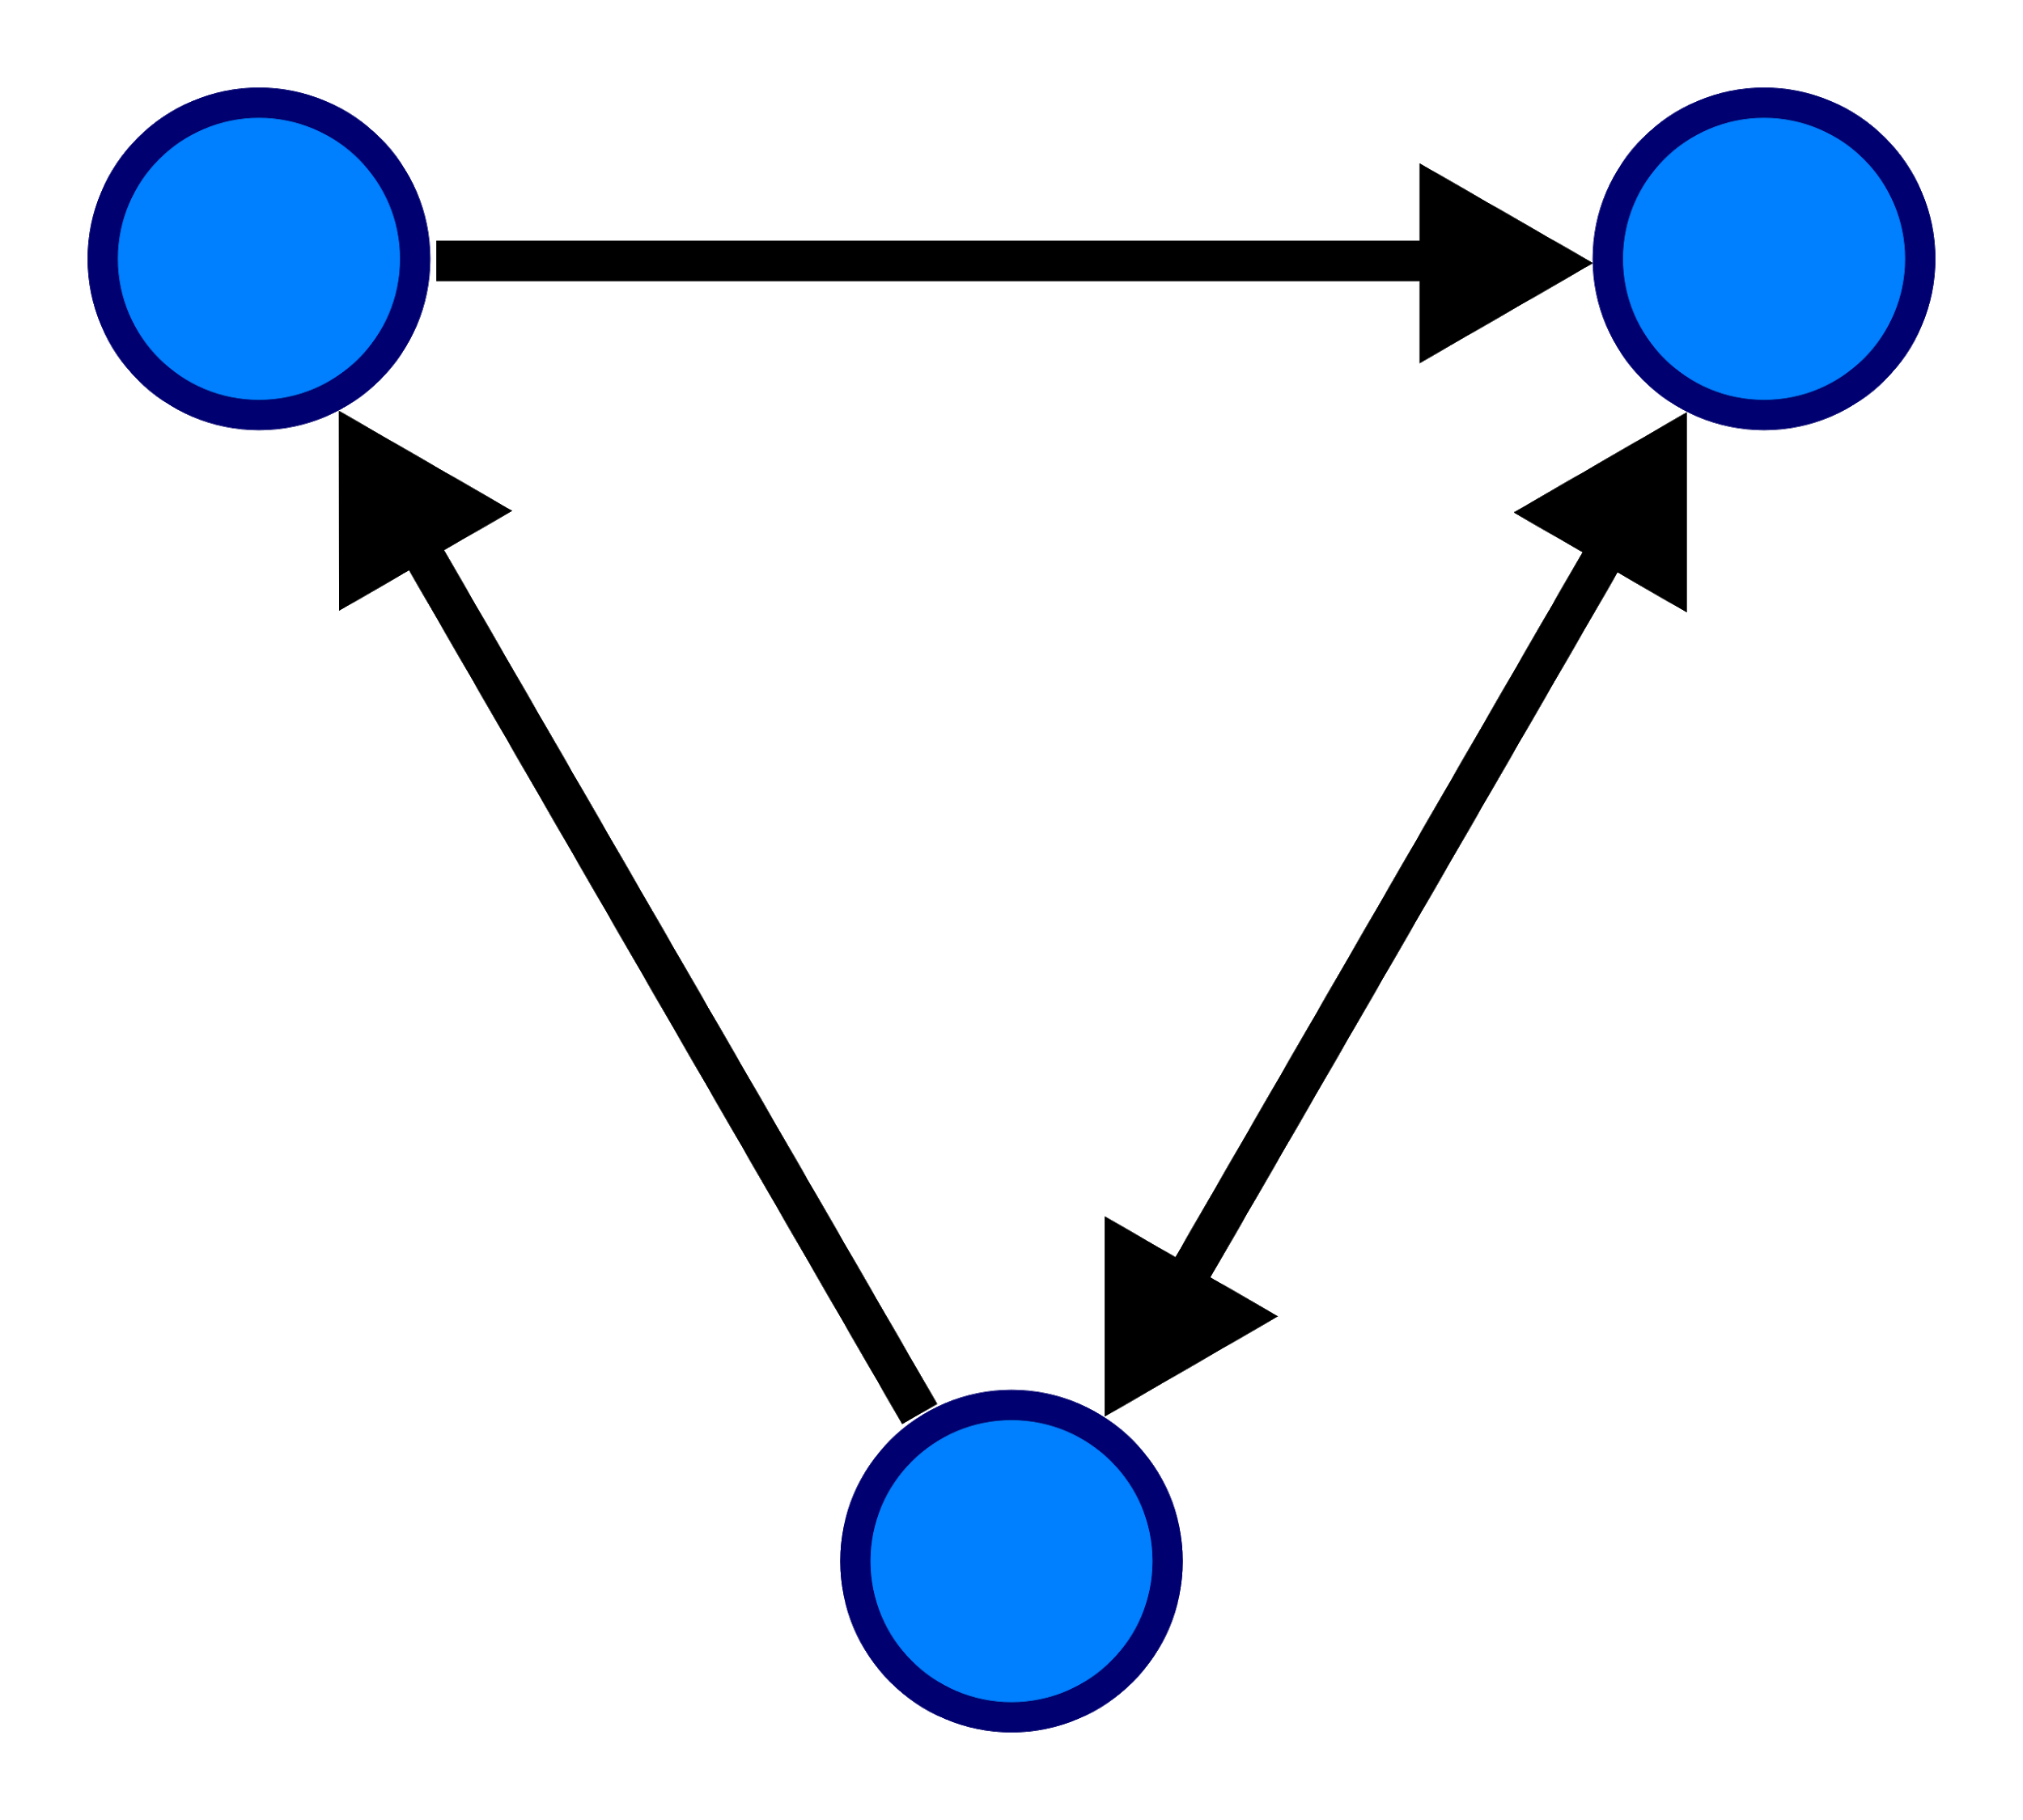
Undirected & Directed graph
Edge with orientation may have e(x,y) != e(y,x)
Graph have no edge with orientation is undirected graph
Graph have edges with orientation is directed graph (or digraph)
Degree:
Undirected graph: number of edge of that vertex
Directed graph: sum of number of outbound edges & inbound edges.

Slide 6
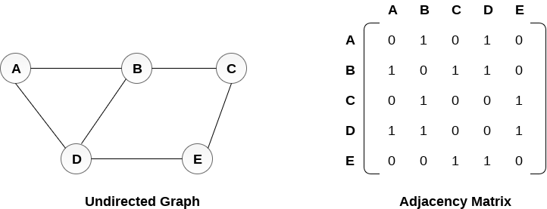
Implementation
With adjacency matrix
2-dimensional matrix A
A[x,y] represent edge (x,y)

Slide 7
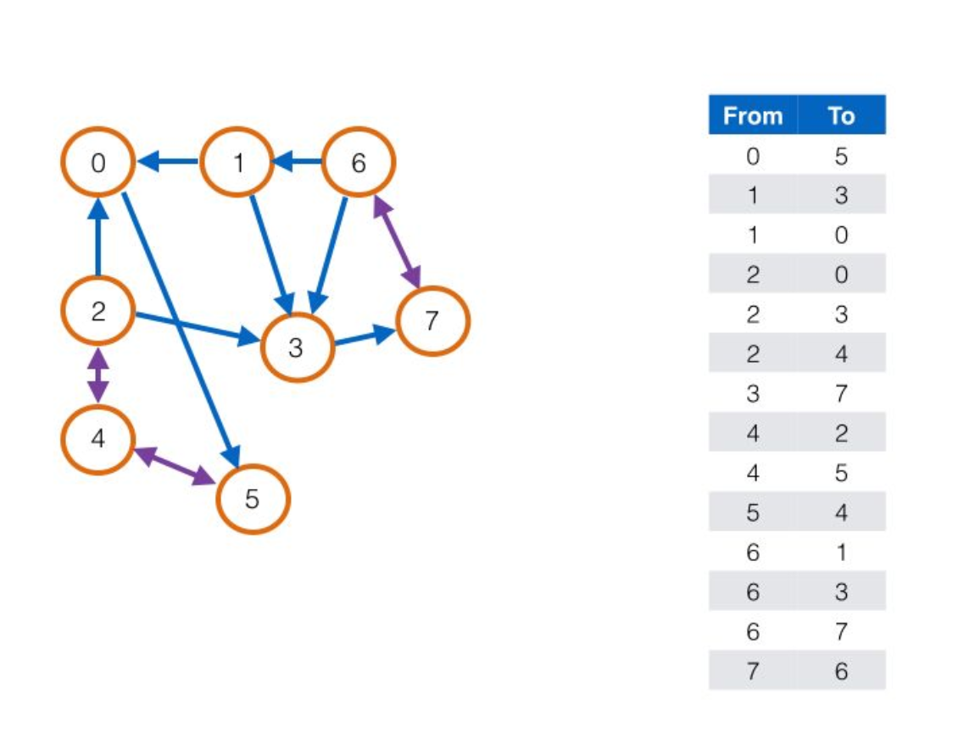
Implementation
List of edges
Each list item represent an edge, which has vertex from & vertex to

Slide 8
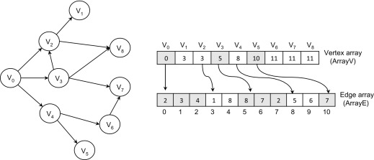
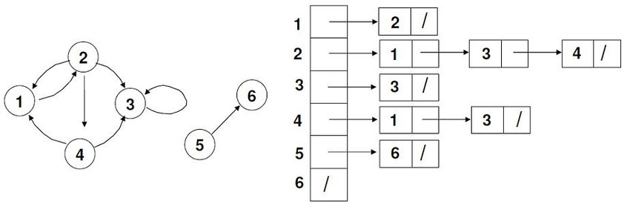
Implementation
Adjacent edges
2 arrays:
Array V: V[x] store the first position from x in array E
Array E: E[y] store the vertex to
Linked list

Slide 9
Implementation
Used in modern programming language
Map & combined key:
Extended from Adjacency Matrix
f(x,y) is key generated function
A[f(x,y)] represent edge (x,y)
result of f(x,y) must be unique ⇔ for any vertex x,y,z,t where x != y != z != t, we have: f(x,y) != f(z,t)

Slide 10
Pathfinding
Basic problems:
Find a route from vertex X to vertex Y
Find all route from vertex X to vertex Y
Find shortest route from vertex X to vertex Y
No-weight graph
Have-weight graph
Find shortest route from vertex X to one of set of vertex

Slide 11
Depth First Search (DFS)
Concept:
Go as deep as possible
Step back if don't find any new route from current position
Stop the algorithm if:
Found the path
Current position is starting position and there is no route to go

Slide 12
Depth First Search (DFS) - Algorithm
With recursive
function findPath(fromVertex, currentPath){
nearVertices = getNearVertices(fromVertex)
nearVertices.foreach(function(vertex){
if vertex == targetVertex {
writeOutput(currentPath)
return
}
currentPath.add(vertex)
findPath(vert, currentPath)
currentPath.remove(vertex)
})
}
findPath(startVertex, [startVertex])

Slide 13
Depth First Search (DFS) - Algorithm
Without recursive
→ Homework 1

Slide 14
Breadth First Search (BFS)
Concept:
Scan nearest (neighbor) vertices from current position
Trace with previous-mark

Slide 15
Breadth First Search (BFS)
vertices = [ startVertex ]
before = [len(vertex)]
while !isEmpty(vertices) {
currentVertex = vertices.removeFirst()
nearVertices = getNearVertices(fromVertex)
nearVertices.foreach(function(vertex){
if vertex == targetVertex {
writeOutput()
return
}
if isEmpty(before[vertex]) {
before[vertex] = currentVertex
vertices.add(vertex)
}
})
}

Slide 16
Homework
Find a path from X to Y
Implement DFS without recursive
Implement BFS
Implement graph model with 4 ways of representation:
Adjacency matrix
List of edges
Adjacency edges
Map with combined key

Slide 17
Q & A

